Slide 1

Process-to-Process Delivery:
UDP, TCP, and SCTP
23.<number>
Copyright © The McGraw-Hill Companies, Inc. Permission required for reproduction or display.

Slide 2
23-1 PROCESS-TO-PROCESS DELIVERY
The transport layer is responsible for process-to-process delivery—the delivery of a packet, part of a message, from one process to another. Two processes communicate in a client/server relationship, as we will see later.
Topics discussed in this section:
Client/Server Paradigm
Multiplexing and Demultiplexing
Connectionless Versus Connection-Oriented Service
Reliable Versus Unreliable
Three Protocols
23.<number>

Slide 3

Note
The transport layer is responsible for process-to-process delivery.
23.<number>

Slide 4
PROCESS-TO-PROCESS DELIVERY
The data link layer is responsible for delivery of frames between two neighbouring nodes over a link. This is called node-to-node delivery.
The network layer is responsible for delivery of datagrams between two hosts. This is called host-to-host delivery.
Communication on the Internet is not defined as the exchange of data between two nodes or between two hosts.
Real communication takes place between two processes (application programs). We need process-to-process delivery.
However, at any moment, several processes may be running on the source host and several on the destination host.
To complete the delivery, we need a mechanism to deliver data from one of these processes running on the source host to the corresponding process running on the destination host.
The transport layer is responsible for process-to-process delivery—the delivery of a packet, part of a message, from one process to another.
Figure 23.1 shows these three types of deliveries and their domains.
23.<number>

Slide 5

Figure 23.1 Types of data deliveries
23.<number>

Slide 6
Client/Server Paradigm
Although there are several ways to achieve process-to-process communication, the most common one is through the client/server paradigm.
A process on the local host, called a client, needs services from a process usually on the remote host, called a server.
23.<number>

Slide 7
Addressing
Whenever we need to deliver something to one specific destination among many, we need an address.
At the data link layer, we need a MAC address to choose one node among several nodes if the connection is not point-to-point.
At the network layer, we need an IP address to choose one host among millions.
At the transport layer, we need a transport layer address, called a port number, to choose among multiple processes running on the destination host.
The destination port number is needed for delivery; the source port number is needed for the reply.
23.<number>

Slide 8

Figure 23.2 Port numbers
23.<number>

Slide 9

Figure 23.3 IP addresses versus port numbers
23.<number>

Slide 10
IANA Ranges
The IANA (Internet Assigned Number Authority) has divided the port numbers into
three ranges: well known, registered, and dynamic (or private), as shown in Figure 23.4.
❏ Well-known ports. The ports ranging from 0 to 1023 are assigned and controlled
by IANA. These are the well-known ports.
❏ Registered ports. The ports ranging from 1024 to 49,151 are not assigned or controlled
by IANA. They can only be registered with IANA to prevent duplication.
❏ Dynamic ports. The ports ranging from 49,152 to 65,535 are neither controlled
nor registered. They can be used by any process. These are the ephemeral ports.
23.<number>

Slide 11

Figure 23.4 IANA ranges
23.<number>

Slide 12
Socket Addresses
Process-to-process delivery needs two identifiers, IP address and the port number, at each end to make a connection.
The combination of an IP address and a port number is called a socket address.
The client socket address defines the client process uniquely just as the server socket address defines the server process uniquely.
A transport layer protocol needs a pair of socket addresses: the client socket address and the server socket address.
These four pieces of information are part of the IP header and the transport layer protocol header.
The IP header contains the IP addresses; the UDP or TCP header contains the port numbers.
23.<number>

Slide 13

Figure 23.5 Socket address
23.<number>

Slide 14
Multiplexing and Demultiplexing
The addressing mechanism allows multiplexing and demultiplexing by the transport layer.
Multiplexing
At the sender site, there may be several processes that need to send packets. However, there is only one transport layer protocol at any time.
This is a many-to-one relationship and requires multiplexing.
The protocol accepts messages from different processes, differentiated by their assigned port numbers.
After adding the header, the transport layer passes the packet to the network layer.
Demultiplexing
At the receiver site, the relationship is one-to-many and requires demultiplexing.
The transport layer receives datagrams from the network layer.
After error checking and dropping of the header, the transport layer delivers each message to the appropriate process based on the port number.
23.<number>

Slide 15

Figure 23.6 Multiplexing and demultiplexing
23.<number>

Slide 16
Connectionless Versus Connection-Oriented Service
A transport layer protocol can either be connectionless or connection-oriented.
Connectionless Service
In a connectionless service, the packets are sent from one party to another with no need for connection establishment or connection release.
The packets are not numbered; they may be delayed or lost or may arrive out of sequence.
There is no acknowledgment either.
One of the transport layer protocols in the Internet model, UDP, is connectionless.
Connection-Oriented Service
In a connection-oriented service, a connection is first established between the sender and the receiver.
Data are transferred. At the end, the connection is released.
TCP and SCTP are connection-oriented protocols.
23.<number>

Slide 17
Reliable Versus Unreliable
The transport layer service can be reliable or unreliable.
If the application layer program needs reliability, we use a reliable transport layer protocol by implementing flow and error control at the transport layer. This means a slower and more complex service.
On the other hand, if the application program does not need reliability because it uses its own flow and error control mechanism or it needs fast service or the nature of the service does not demand flow and error control, then an unreliable protocol can be used.
23.<number>

Slide 18

Figure 23.7 Error control
23.<number>

Slide 19

Figure 23.8 Position of UDP, TCP, and SCTP in TCP/IP suite
23.<number>

Slide 20
23-2 USER DATAGRAM PROTOCOL (UDP)
The User Datagram Protocol (UDP) is called a connectionless, unreliable transport protocol. It does not add anything to the services of IP except to provide process-to-process communication instead of host-to-host communication.
Topics discussed in this section:
Well-Known Ports for UDP
User Datagram
Checksum
UDP Operation
Use of UDP
23.<number>

Slide 21


Table 23.1 Well-known ports used with UDP
23.<number>

Slide 22
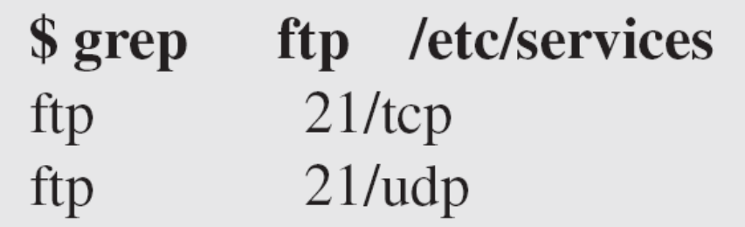
Example 23.1
In UNIX, the well-known ports are stored in a file called /etc/services.
Each line in this file gives the name of the server and the well-known port number.
We can use the grep utility to extract the line corresponding to the desired application.
The following shows the port for FTP.
  Note that FTP can use port 21 with either UDP or TCP.
23.<number>

Slide 23

Example 23.1 (continued)
SNMP uses two port numbers (161 and 162), each for a different purpose.
23.<number>

Slide 24

Figure 23.9 User datagram format
23.<number>

Slide 25
User Datagram
UDP packets, called user datagrams, have a fixed-size header of 8 bytes.
The fields are as follows:
❏ Source port number.
This is the port number used by the process running on the source host.
It is 16 bits long, which means that the port number can range from 0 to 65,535.
If the source host is the client, the port number, in most cases, is an ephemeral port number requested by the process and chosen by the UDP software running on the source host.
If the source host is the server, the port number, in most cases, is a well-known port number.
23.<number>

Slide 26
❏ Destination port number.
This is the port number used by the process running on the destination host. It is also 16 bits long.
If the destination host is the server, the port number, in most cases, is a well-known port number.
If the destination host is the client, the port number, in most cases, is an ephemeral port number.
  In this case, the server copies the ephemeral port number it has received in the request packet.
❏ Length.
This is a 16-bit field that defines the total length of the user datagram, header plus data.
The 16 bits can define a total length of 0 to 65,535 bytes.
However, the total length needs to be much less because a UDP user datagram is stored in an IP datagram with a total length of 65,535 bytes.
23.<number>

Slide 27
❏ Length. (cont…)
The length field in a UDP user datagram is actually not necessary.
A user datagram is encapsulated in an IP datagram.
There is a field in the IP datagram that defines the total length. There is another field in the IP datagram that defines the length of the header.
So if we subtract the value of the second field from the first, we can deduce the length of a UDP datagram that is encapsulated in an IP datagram.
❏ Checksum.
This field is used to detect errors over the entire user datagram (header plus data).
23.<number>

Slide 28
Note
UDP length
= IP length – IP header’s length
23.<number>

Slide 29
Checksum
The UDP checksum calculation is different from the one for IP and ICMP.
Here the checksum includes three sections:
a pseudoheader, the UDP header, and the data coming from the application layer.
The pseudoheader is the part of the header of the IP packet in which the user datagram is to be encapsulated with some fields filled with 0s.
The protocol field is added to ensure that the packet belongs to UDP, and not to other transport-layer protocols.
The value of the protocol field for UDP is 17. ‘
If this value is changed during transmission, the checksum calculation at the receiver will detect it and UDP drops the packet.
  It is not delivered to the wrong protocol.
23.<number>

Slide 30

Figure 23.10 Pseudoheader for checksum calculation
23.<number>

Slide 31
Example 23.2
Figure 23.11 shows the checksum calculation for a very small user datagram with only 7 bytes of data.
Because the number of bytes of data is odd, padding is added for checksum calculation.
The pseudoheader as well as the padding will be dropped when the user datagram is delivered to IP.
23.<number>

Slide 32

Figure 23.11 Checksum calculation of a simple UDP user datagram
23.<number>

Slide 33

Figure 23.12 Queues in UDP
23.<number>

Slide 34
Use of UDP
The following lists some uses of the UDP protocol:
❏ UDP is suitable for a process that requires simple request-response communication with little concern for flow and error control. It is not usually used for a process such as FTP that needs to send bulk data.
❏ UDP is suitable for a process with internal flow and error control mechanisms. For example, the Trivial File Transfer Protocol (TFTP) process includes flow and error control. It can easily use UDP.
❏ UDP is a suitable transport protocol for multicasting. Multicasting capability is embedded in the UDP software but not in the TCP software.
❏ UDP is used for management processes such as SNMP.
❏ UDP is used for some route updating protocols such as Routing Information Protocol (RIP).
23.<number>

Slide 35
23-3 TCP
TCP is a connection-oriented protocol; it creates a virtual connection between two TCPs to send data. In addition, TCP uses flow and error control mechanisms at the transport level.
Topics discussed in this section:
TCP Services
TCP Features
Segment
A TCP Connection
Flow Control
Error Control
23.<number>

Slide 36

Table 23.2 Well-known ports used by TCP
23.<number>

Slide 37

Figure 23.13 Stream delivery
23.<number>

Slide 38

Figure 23.14 Sending and receiving buffers
23.<number>

Slide 39

Figure 23.15 TCP segments
23.<number>

Slide 40
Note
The bytes of data being transferred in each connection are numbered by TCP.
The numbering starts with a randomly generated number.
23.<number>

Slide 41

Example 23.3
The following shows the sequence number for each segment:
23.<number>

Slide 42
Note
The value in the sequence number field of a segment defines the
number of the first data byte
contained in that segment.
23.<number>

Slide 43
Note
The value of the acknowledgment field in a segment defines
the number of the next byte a party expects to receive.
The acknowledgment number is cumulative.
23.<number>

Slide 44

Figure 23.16 TCP segment format
23.<number>

Slide 45

Figure 23.17 Control field
23.<number>

Slide 46

Table 23.3 Description of flags in the control field
23.<number>

Slide 47
Example 23.2.4
The following is a dump of a TCP header in hexadecimal format
05320017 00000001 00000000 500207FF 00000000
What is the source port number?
What is the destination port number?
What is sequence number?
What is the acknowledgment number?
What is the length of the header?
What is the type of the segment?
What is the window size?
22.<number>

Slide 48
Example 23.2.5
To make the initial sequence number a random number, most systems start the counter at 1 and increase the counter by 64000 every 0.5s, how long does it take for the counter to wrap around?
22.<number>

Slide 49

Figure 23.18 Connection establishment using three-way handshaking
23.<number>

Slide 50
Note
A SYN segment cannot carry data, but it consumes one sequence number.
23.<number>

Slide 51
Note
A SYN + ACK segment cannot
carry data, but does consume one
sequence number.
23.<number>

Slide 52
Note
An ACK segment, if carrying no data, consumes no sequence number.
23.<number>

Slide 53
Example 23.2.6
TCP opens a connections using an initial sequence number (ISN) of 14534. The other party opens the connection with an ISN of 21732. Show the three TCP segment during the connection establishment.
22.<number>

Slide 54

Figure 23.19 Data transfer
23.<number>

Slide 55

Figure 23.20 Connection termination using three-way handshaking
23.<number>

Slide 56
Note
The FIN segment consumes one sequence number if it does
not carry data.
23.<number>

Slide 57
Note
The FIN + ACK segment consumes
one sequence number if it
does not carry data.
23.<number>

Slide 58

Figure 23.21 Half-close
23.<number>

Slide 59

Figure 23.22 Sliding window
23.<number>

Slide 60
Note
A sliding window is used to make transmission more efficient as well as
to control the flow of data so that the destination does not become
overwhelmed with data.
TCP sliding windows are byte-oriented.
23.<number>

Slide 61
Example 23.4
What is the value of the receiver window (rwnd) for host A if the receiver, host B, has a buffer size of 5000 bytes and 1000 bytes of received and unprocessed data?
Solution
The value of rwnd = 5000 − 1000 = 4000. Host B can receive only 4000 bytes of data before overflowing its buffer. Host B advertises this value in its next segment to A.
23.<number>

Slide 62
Example 23.5
What is the size of the window for host A if the value of rwnd is 3000 bytes and the value of cwnd is 3500 bytes?
Solution
The size of the window is the smaller of rwnd and cwnd, which is 3000 bytes.
23.<number>

Slide 63
Example 23.6
Figure 23.23 shows an unrealistic example of a sliding window. The sender has sent bytes up to 202. We assume that cwnd is 20 (in reality this value is thousands of bytes). The receiver has sent an acknowledgment number of 200 with an rwnd of 9 bytes (in reality this value is thousands of bytes). The size of the sender window is the minimum of rwnd and cwnd, or 9 bytes. Bytes 200 to 202 are sent, but not acknowledged. Bytes 203 to 208 can be sent without worrying about acknowledgment. Bytes 209 and above cannot be sent.
23.<number>

Slide 64

Figure 23.23 Example 23.6
23.<number>

Slide 65
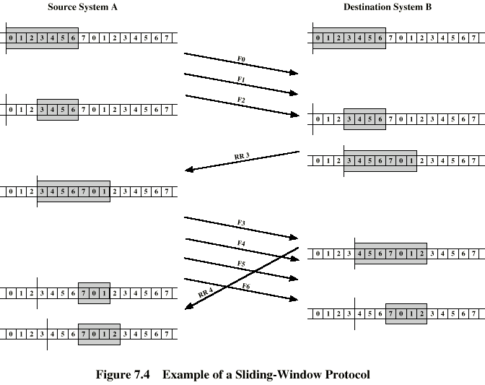
Example Sliding Window

Slide 66
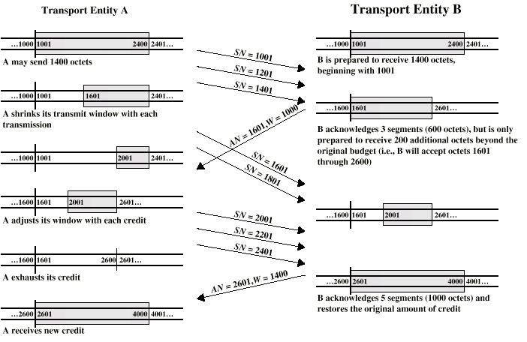
Credit Allocation

Slide 67
Example 24
A TCP connection is using a window size of 10,000 bytes, and the previous acknowledgement number was 22,001. It receives a segment with acknowledgment number 24,001 and window size advertisement of 12,000. Draw a diagram to show the situation of the window before and after.
22.<number>

Slide 68
Example 25
A window holds bytes 2001 and 5000. The next byte to be sent is 3001. Draw a figure to show the situation of the window after the following two events:
An ACK segment with the acknowledgement number 25, 000 and window size advertisement 4,000 is received.
A segment carrying 1000 bytes is sent.
22.<number>

Slide 69
Note
Some points about TCP sliding windows:
❏ The size of the window is the lesser of rwnd and
cwnd.
❏ The source does not have to send a full window’s
worth of data.
❏ The window can be opened or closed by the
receiver, but should not be shrunk.
❏ The destination can send an acknowledgment at
any time as long as it does not result in a shrinking
window.
❏ The receiver can temporarily shut down the
window; the sender, however, can always send a
segment of 1 byte after the window is shut down.
23.<number>

Slide 70
Note
ACK segments do not consume sequence numbers and are not acknowledged.
23.<number>

Slide 71
Note
In modern implementations, a retransmission occurs if the retransmission timer expires or three duplicate ACK segments have arrived.
23.<number>

Slide 72
Note
No retransmission timer is set for an ACK segment.
23.<number>

Slide 73
Note
Data may arrive out of order and be temporarily stored by the receiving TCP,
but TCP guarantees that no out-of-order segment is delivered to the process.
23.<number>

Slide 74

Figure 23.24 Normal operation
23.<number>

Slide 75

Figure 23.25 Lost segment
23.<number>

Slide 76
Note
The receiver TCP delivers only ordered data to the process.
23.<number>

Slide 77

Figure 23.26 Fast retransmission
23.<number>

